Slide 1
Whole building energy modeling of SinBerBEST technologies: Baseline model and examples of energy saving solutions
Carlos Duarte
Paul Raftery
Stefano Schiavon
Center for the Built Environment
University of California, Berkeley

Slide 2
Building energy simulation
Source: David Sheer Autodesk

Slide 3
Model development process

Slide 4
Benchmark characteristics
Office floors: 17
Total area: 23,800 m²
Floor plate area: 1,400 m² Floor plate shape: Squared
Exterior wall layers:
6 mm glass
150 mm air gap
3 mm aluminum shadow box
75 mm semi-rigid insulation
U-value: 0.416 W/m²·K
Green Mark points (energy section):
30 points
ETTV: 50 W/m²

Slide 5
Benchmark internal loads
Office design peak internal loads:
Lights: 15 W/m²
Plug loads: 14 W/m²
Ventilation: 5.5 l/s·person
People: 10 m²/person
130 W/person
Infiltration: 0.2 ACH
Average occupied weekday loads:
Lights: 10.6 W/m²
Plug loads: 9.4 W/m²
Ventilation: 8.2 l/s·person
People: 13.1 m²/person
130 W/person
Infiltration: 0.2 ACH-ACMV OFF
0.05 ACH-ACMV ON

Slide 6
Benchmark energy consumption

Slide 7
Benchmark cooling loads
29% of total

Slide 8
Benchmark cooling loads
86% latent / 14% sensible

Slide 9
Benchmark cooling loads
29%
20%
15%
15%
15%

Slide 10
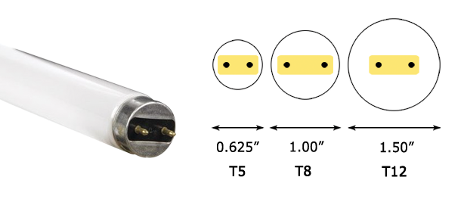
Thrust 3: Daylight control and lamps
Chien SC & Tseng K J (2014) Assessment of climate-based daylight, International Journal of Low-Carbon Technologies

Slide 11
Thrust 4: Increased temperature setpoint
Comfort at 23 °C
Still air
Comfort at 26 °C
Air movement
Comfort at 29 °C
More air movement
S Schiavon & A K Melikov (2008) Energy saving and improved comfort by increased air movement, Energy and Buildings
D Rim, S Schiavon, W.W. Nazaroff (2015) Energy and Cost Associated with Ventilating Office Buildings in a Tropical Climate, PLoS One
T Hoyt, E. Arens, H. Zhang (2015) Extending air temperature setpoints: Simulated energy savings and design considerations for new and retrofit buildings, Building and Environment

Slide 12
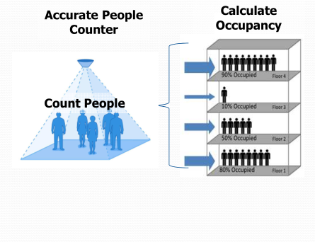
Thrust 1, 2, 3 and 4: Indoor localization
Z. Chen, H. Zou, H. Jiang, Q. Zhu, Y. Soh, L. Xie (2015) Fusion of WiFi, Smartphone Sensors and Landmarks Using the Kalman Filter for Indoor Localization, Sensors
M. Jin, R. Jin, Z. Kang, I.C. Konstantakopoulos, C.J. Spanos, (2014) PresenceSense: Zero-training Algorithm for Individual Presence Detection based on Power Monitoring, Buildsys Conference ’14

Slide 13
Combined strategies
Increased temperature set points
Zones increased from 23 to 26°C
True occupancy knowledge*
Demand control ventilation
Plug load schedule reduced by 30%
Lighting load schedule reduced by 60%
Use of LED lamps and daylight control
* J Halvarsson (2012) Occupancy pattern in office buildings Doctoral thesis, Norwegian University of Science and Technology

Slide 14
Results
Adjusted baseline
SinBerBEST technologies
46% energy savings

Slide 15
Changing envelope construction
All glass façade
U-value: 0.42 W/m²·K
Assembly layers from exterior to interior
6 mm glass
150 mm air gap
3 mm shadow box
75 mm rigid insulation
WWR: 59%
ETTV: 50 W/m²
Concrete façade
U-value: 5.58 W/m²·K
Assembly layers from exterior to interior
20 mm cement-sand plaster
150 mm RC concrete wall
20 mm cement-sand plaster
WWR: 35%
ETTV: 50 W/m²

Slide 16
Changing envelope construction
220% increase
46% decrease
All glass benchmark model
Concrete benchmark model

Slide 17
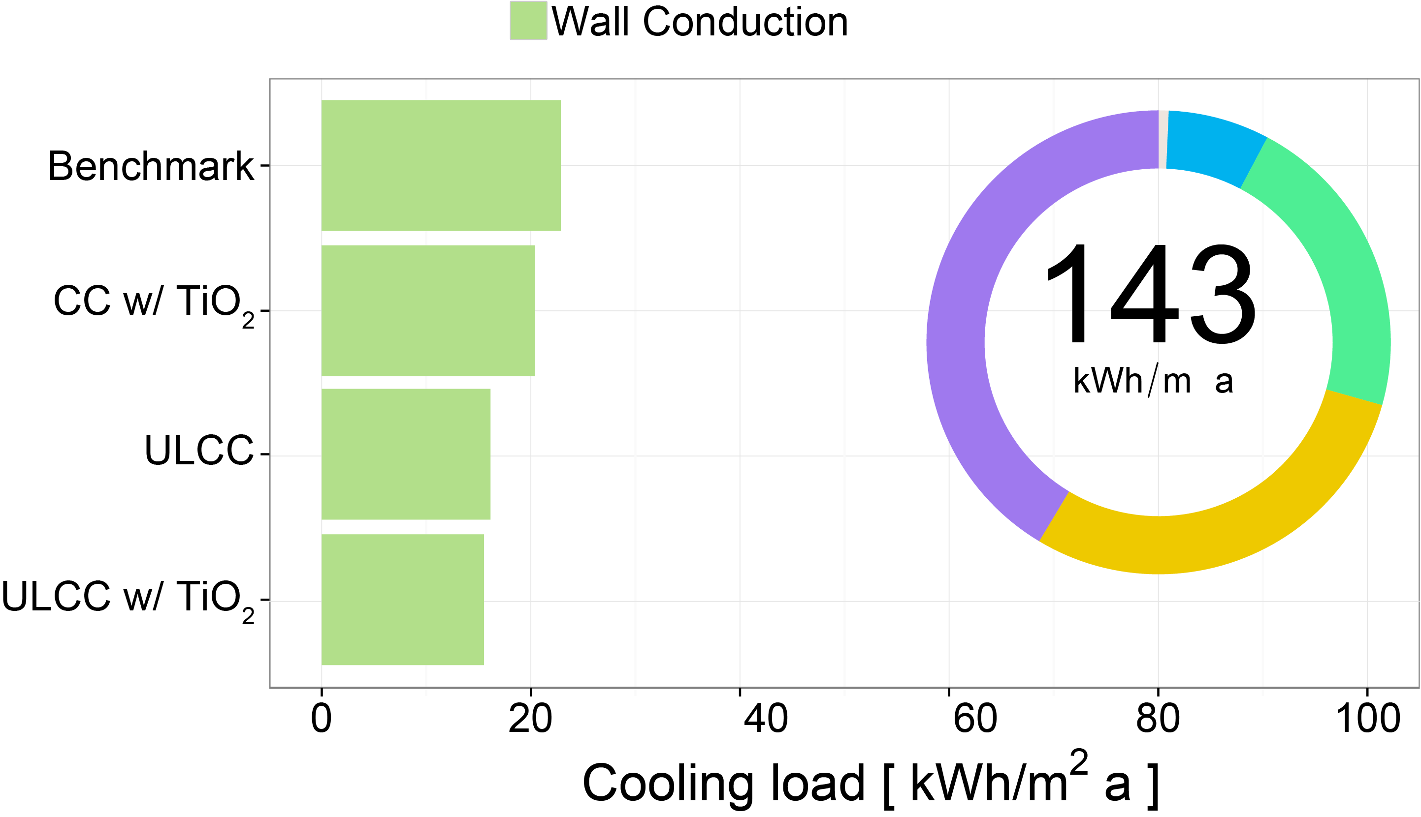
Cooling load reductions
11%
29%
32%

Slide 18
Translucent concrete panels
TC panels assumed in red colored area
TC panels only in perimeter zones
Concentration of optic fibers was varied
Plenum: no TC panels
Windows
A. Ahuja, N. Casquero-Modrego, K. Mosalam Evaluation of Translucent Concrete using ETTV-based Approach, in: ICBEST 2015, IEEE, Singapore

Slide 19
Overall savings from TC panels
Optic fiber concentration 10% for installed area

Slide 20
Conclusions
SinBerBEST technologies have the potential to save large amount of energy
Ventilation and windows have a large energy cost
Sensing occupant present and adapting lighting, ACMV and plug load to it may be a game changer
Push for more building data collection mechanisms is key to understand the dynamics of Singaporean building stock

